Slide 1
NEURAL NETWORKS

Slide 2
Artificial Intelligent Systems
We can debate endlessly about whether a certain system is intelligent or not …
SW programs or SW/HW systems designed
to perform complex tasks
employing strategies that mimic some aspect of human thought
the key is evolution: it is intelligent if it can learn (even if only a limited sense) and/or get better in time themselves.

Slide 3
Artificial Intelligence (AI) vs Machine learning (ML)
AI: is the broader concept of machines being able to carry out tasks in a way that we would consider “smart”.
ML: an application of AI based around the idea that we should really just be able to give machines access to data and let them learn for

Slide 4
ML in a metaphor
It’s like gardening
Seeds = Algorithms
Nutrients = Data
Gardener = You
Plants = Programs/ trained models

Slide 5
Not for all applications..
IF
the nature of computations required in a task is not well understood
or there are too many exceptions to the rules
or known algorithms are too complex or inefficient
THEN
AI can be considered as a possible solution

Slide 6
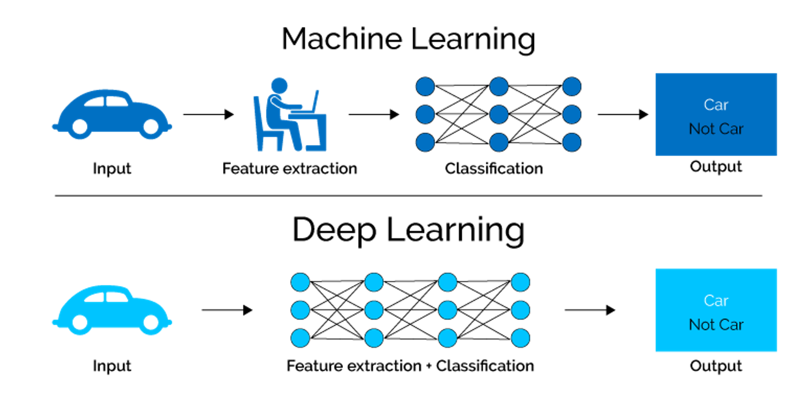
Traditional ML vs Deep Learning
Convolutional Neural Networks

Slide 7
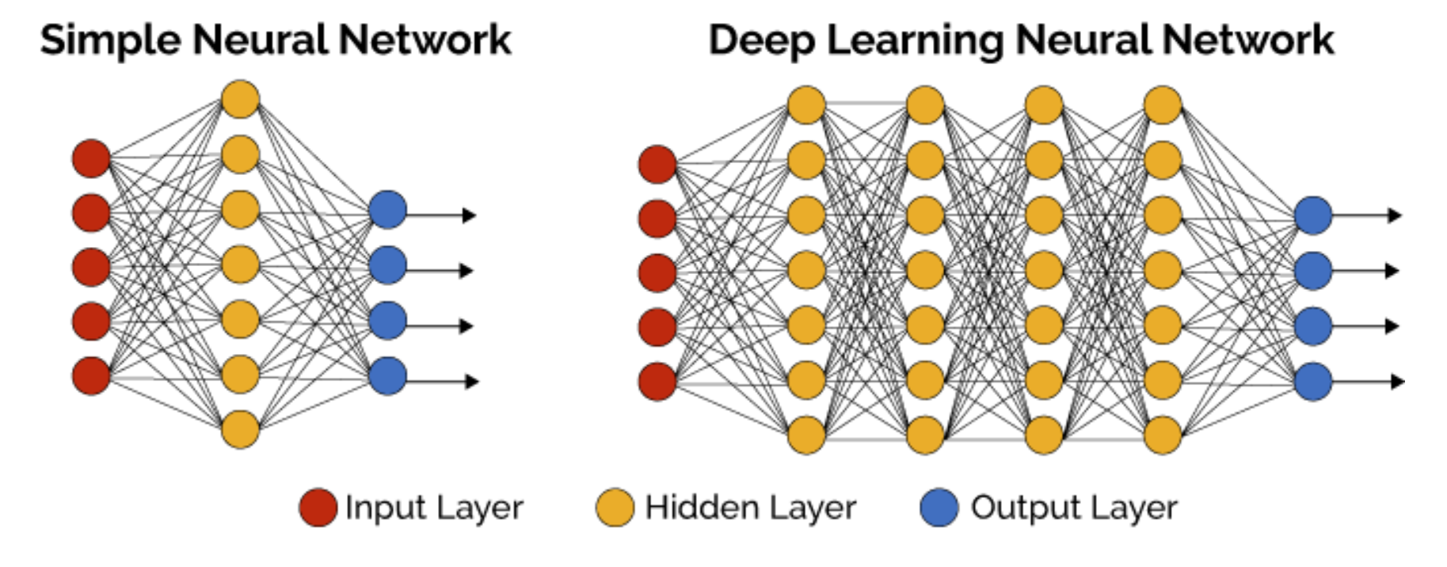
Traditional and Deep Learning networks

Slide 8
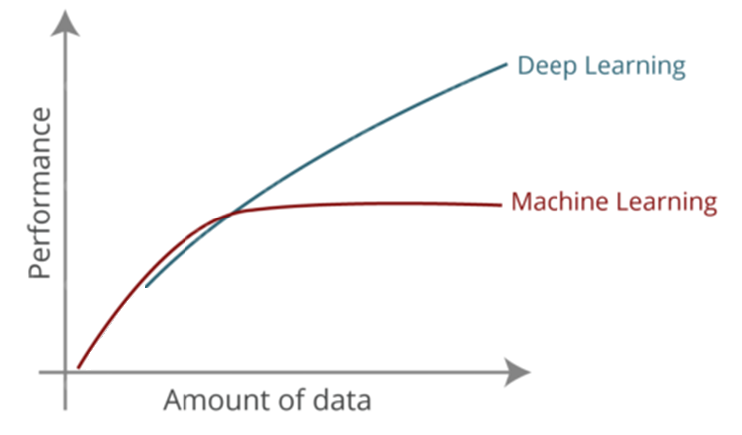
Classical ML vs DeepLearning
(classical)
DL needs data….

Slide 9
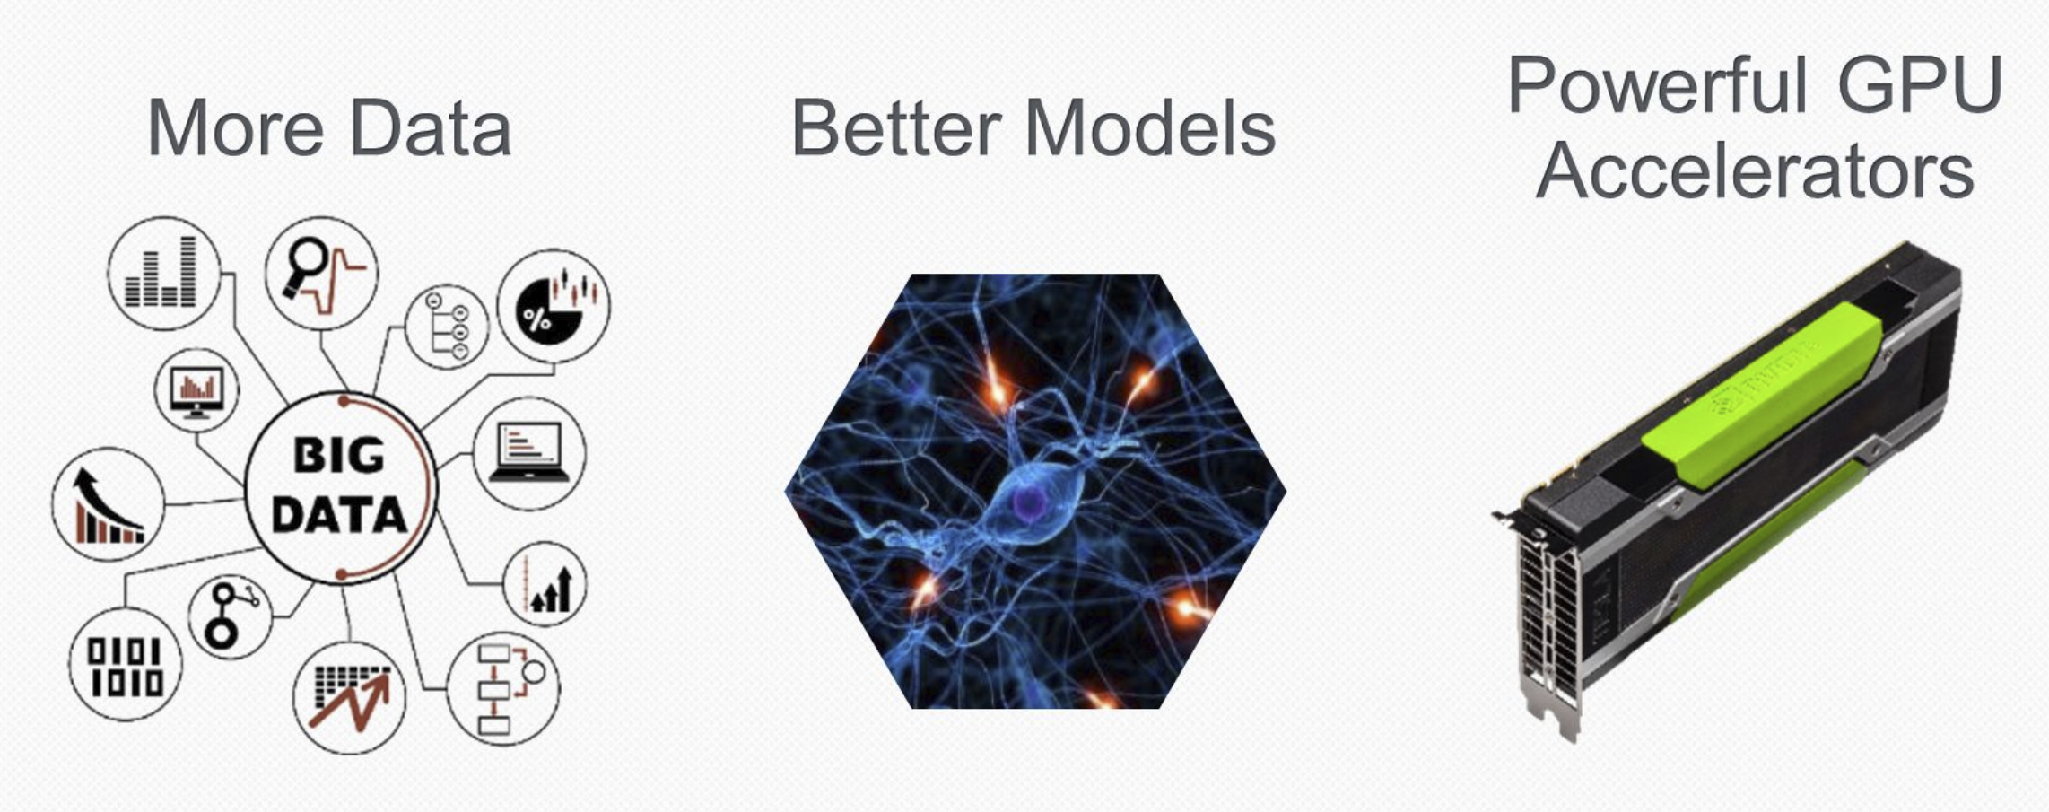
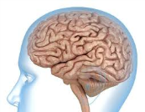
Three main drivers for AI
and Algorithms
Especially for Deep Learn

Slide 10
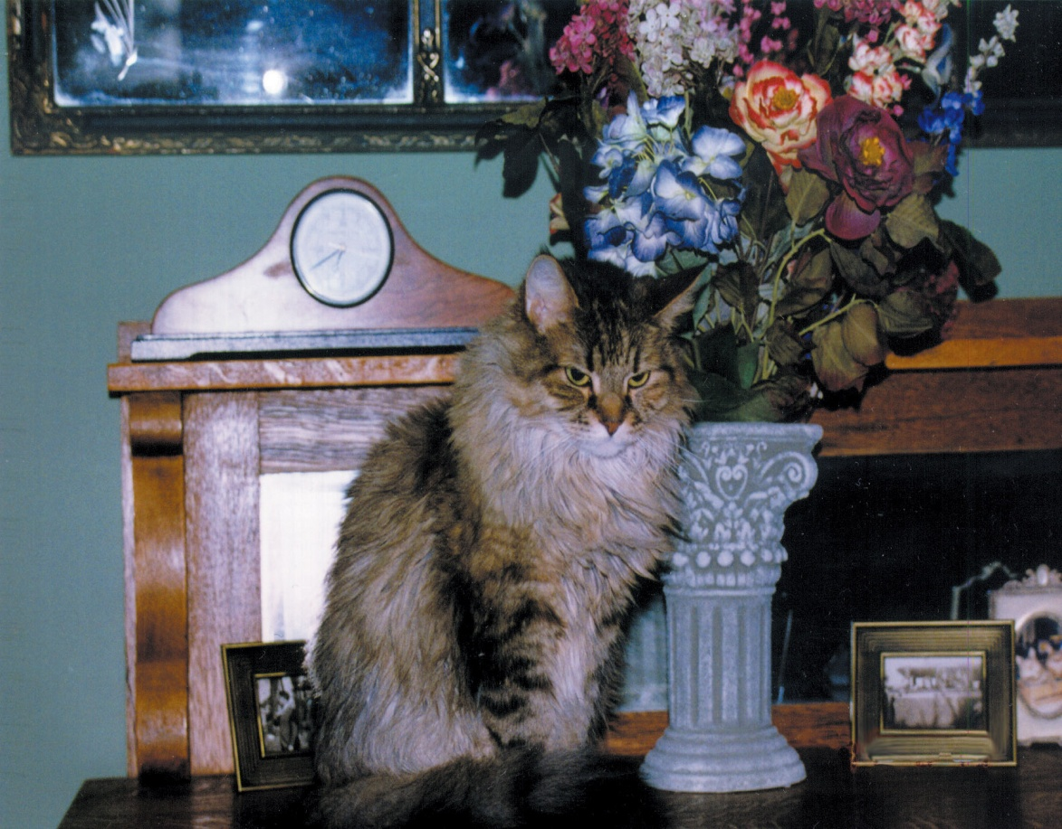
Thinking Machines
A computer would have difficulty identifying the cat, or matching it to another picture of a cat.
10
Notes:
10

Slide 11
Expert Systems
Knowledge-based system
Software that uses a specific set of information, from which it extracts and processes particular pieces
Expert system
A software system based the knowledge of human experts; it is a
Rule-based system
A software system based on a set of if-then rules
Inference engine
The software that processes rules to draw conclusions

Slide 12
Expert Systems
Named abbreviations that represent conclusions
NONE—apply no treatment at this time
TURF—apply a turf-building treatment
WEED—apply a weed-killing treatment
BUG—apply a bug-killing treatment
FEED—apply a basic fertilizer treatment
WEEDFEED—apply a weed-killing and fertilizer combination treatment

Slide 13
Expert Systems
Some rules
if (CURRENT – LAST < 30) then NONE
if (SEASON = winter) then not BUGS
if (BARE) then TURF
if (SPARSE and not WEEDS) then FEED
if (BUGS and not SPARSE) then BUG
if (WEEDS and not SPARSE) then WEED
if (WEEDS and SPARSE) then WEEDFEED

Slide 14
Expert Systems
An execution of our inference engine
System: Does the lawn have large, bare areas?
User: No
System: Does the lawn show evidence of bugs?
User: No
System: Is the lawn generally thin?
User: Yes
System: Does the lawn contain significant weeds?
User: Yes
System: You should apply a weed-killing and fertilizer combination treatment.

Slide 15
Artificial Neural Networks
Computational models inspired by the human brain:
Algorithms that try to mimic the brain.
Massively parallel, distributed system, made up of simple processing units (neurons)
Synaptic connection strengths among neurons are used to store the acquired knowledge.
Knowledge is acquired by the network from its environment through a learning process

Slide 16
History
late-1800's - Neural Networks appear as an analogy to biological systems
1960's and 70's – Simple neural networks appear
Fall out of favor because the perceptron is not effective by itself, and there were no good algorithms for multilayer nets
1986 – Backpropagation algorithm appears
Neural Networks have a resurgence in popularity
More computationally expensive

Slide 17
Applications of ANNs
ANNs have been widely used in various domains for:
Pattern recognition
Function approximation
Associative memory

Slide 18
Properties
Inputs are flexible
any real values
Highly correlated or independent
Target function may be discrete-valued, real-valued, or vectors of discrete or real values
Outputs are real numbers between 0 and 1
Resistant to errors in the training data
Long training time
Fast evaluation
The function produced can be difficult for humans to interpret

Slide 19
When to consider neural networks
Input is high-dimensional discrete or raw-valued
Output is discrete or real-valued
Output is a vector of values
Possibly noisy data
Form of target function is unknown
Human readability of the result is not important
Examples:
Speech phoneme recognition
Image classification
Financial prediction

Slide 20
Artificial Neural Network
Artificial neural networks
A computer representation of knowledge that attempts to mimic the neural networks of the human body
Yes, but what is a human neural network?

Slide 21
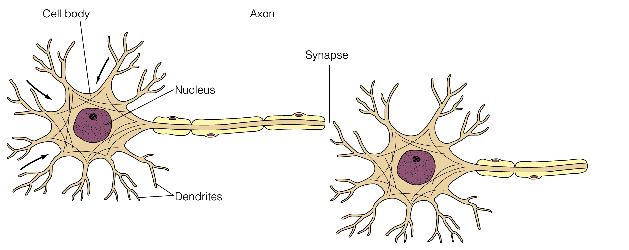
Neural Network
Figure 13.6 A biological neuron

Slide 22
Neural Network
Neuron
A single cell that conducts a chemically-based electronic signal
At any point in time a neuron is in either an excited state or an inhibited state
Excited state
Neuron conducts a strong signal
Inhibited state
Neuron conducts a weak signal

Slide 23
Neural Network
A series of connected neurons forms a pathway
A series of excited neurons creates a strong pathway
A biological neuron has multiple input tentacles called dendrites and one primary output tentacle called an axon
The gap between an axon and a dendrite is called a synapse

Slide 24
Neural network
A neuron accepts multiple input signals and then controls the contribution of each signal based on the “importance” the corresponding synapse gives to it

Slide 25
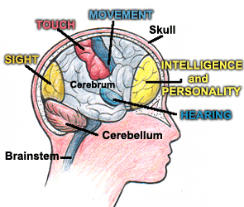
Neural Network
The pathways along the neural nets are in a constant state of flux
As we learn new things, new strong neural pathways in our brain are formed

Slide 26
Artificial Neural Networks
Each processing element in an artificial neural net is analogous to a biological neuron
An element accepts a certain number of input values (dendrites) and produces a single output value (axon) of either 0 or 1
Associated with each input value is a numeric weight (synapse)

Slide 27
Artificial Neural Networks
The process of adjusting the weights and threshold values in a neural net is called training
A neural net can presumably be trained to produce whatever results are required
But think about the complexity of this! Train a computer to recognize any cat in a picture, based on training run with several pictures.

Slide 28
Human vs. Computer
 | Human Brain | Computer
speed | Neurotransmitters travel at about 1000 ft/second | Electrons at speed of light
memory | Roughly 100 billion neurons - about 50 trillion bits | Top super computers might approach this much memory
other | Each neuron connected to 1000 others (roughly) | Perhaps 100 parallel processors

